Slide 1


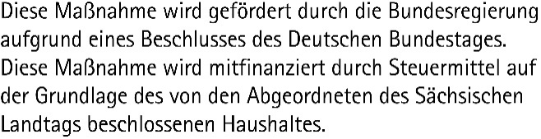
Data Science and AI for Medicine Training School
TRAINING: Large Language Models and AI Assistants
SPEAKER:

Slide 2
LLM Services What is an LLM?
Advanced AI models (Neural Networks / Deep Learning), trained on large amounts of text data
Aim to understand and generate human language
Can take context into account and interact with users
Can perform a variety of tasks depending on further specialization:
Answering questions
Summarizing texts
Translating
Generating code
Additional functions, e.g. web search
What means NLP?
NLP, or “Natural Language Processing”..
Summarize the content in paper.pdf
In this article, the authors claim …
Translate „Hello world“
Hallo Welt
Write a Python function which adds two given numbers
def add(a, b):
result = a + b
return result

Slide 3
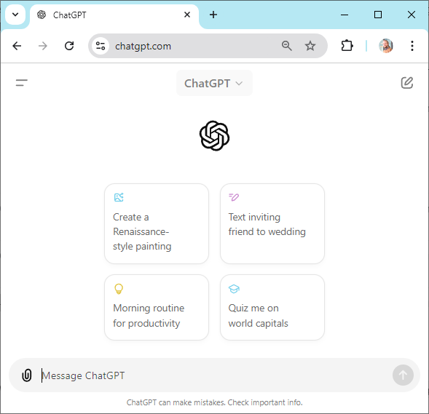
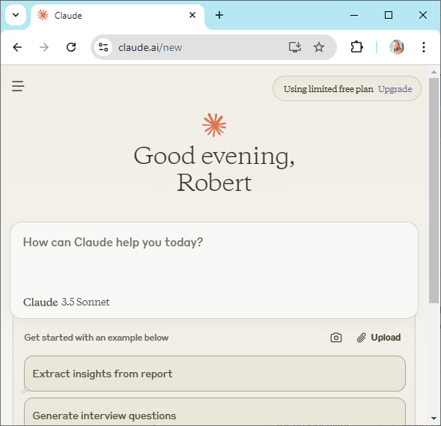
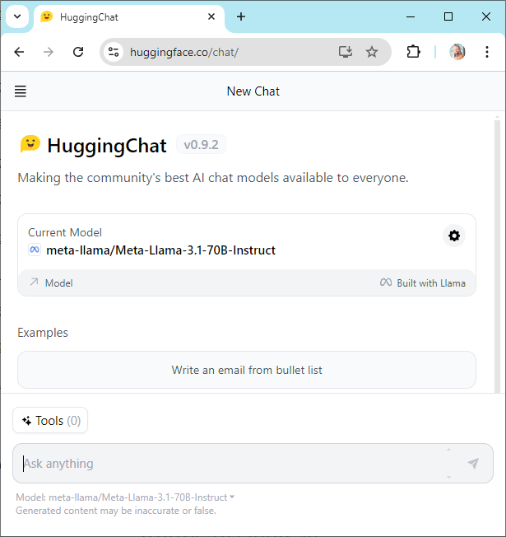
LLM Services Setup and usage
ChatGPT
Claude
Open models
https://chatgpt.com/
https://claude.ai/
https://huggingface.co/chat/

Slide 4
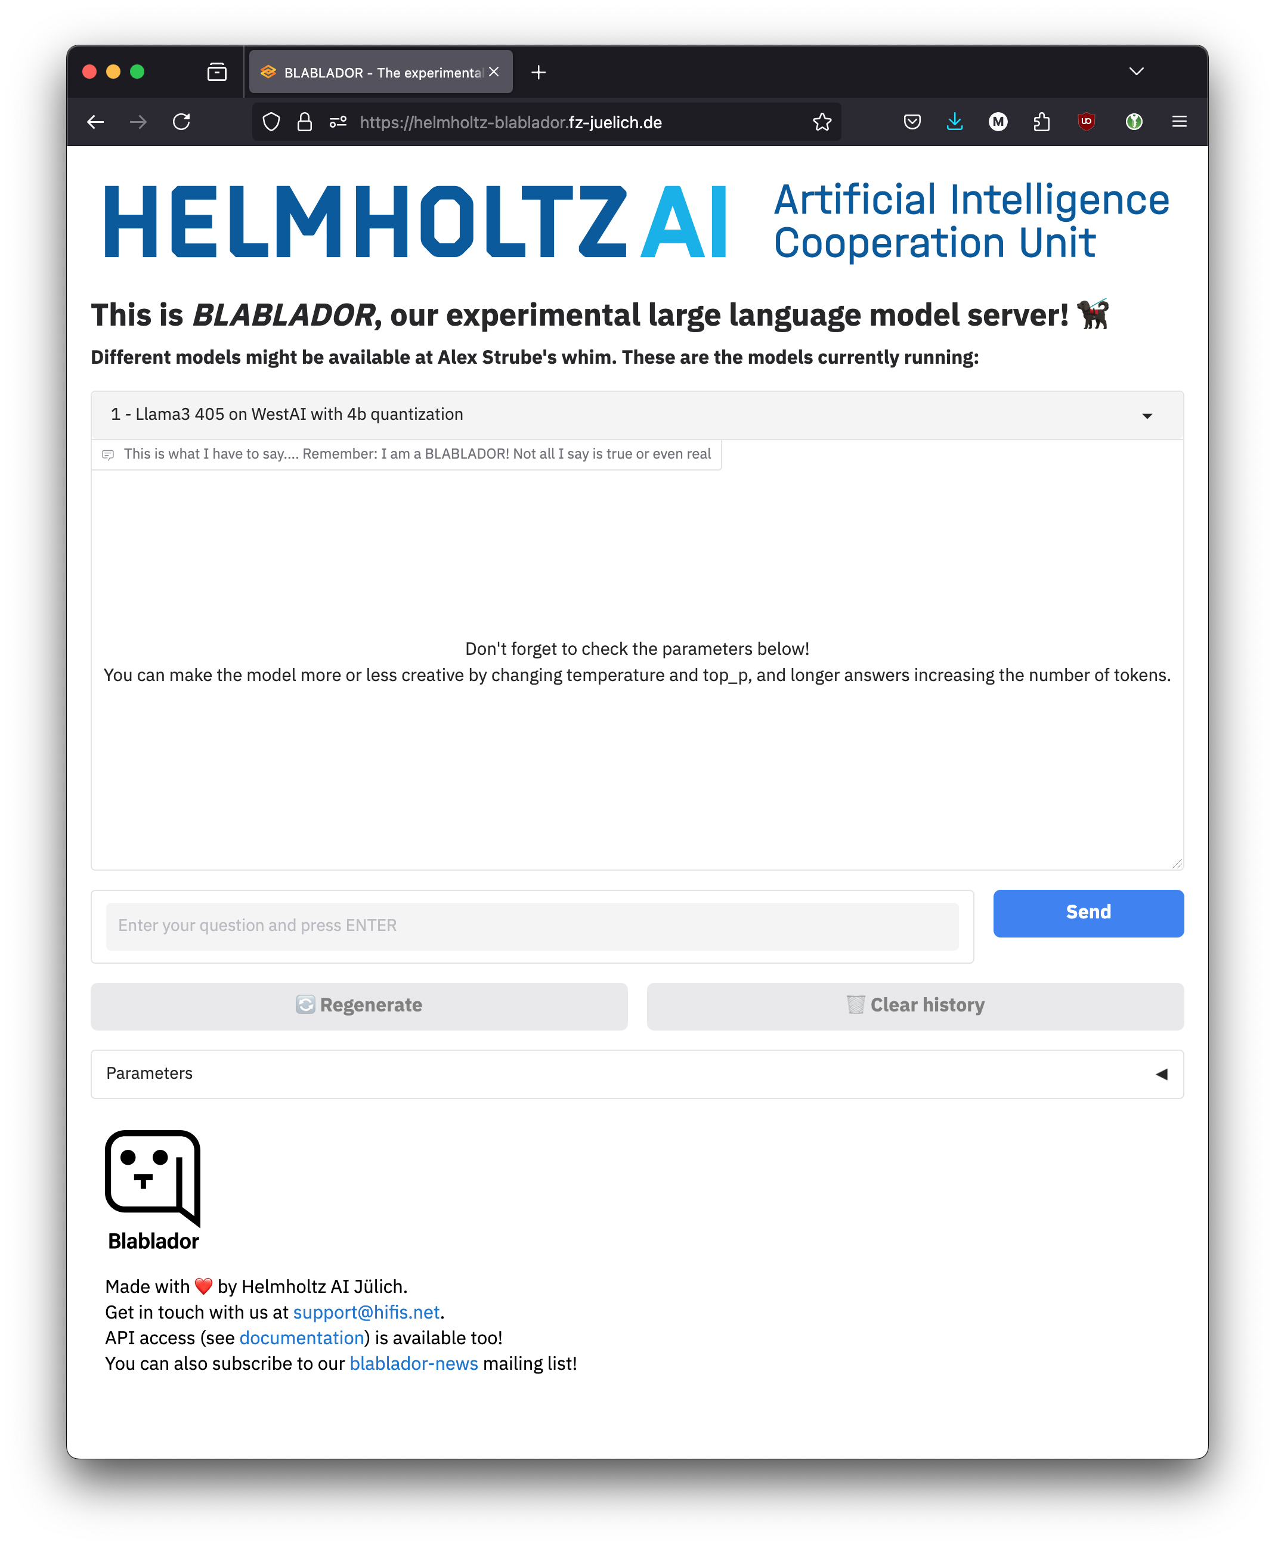
LLM Services Setup and usage
Helmholtz Blablador
Various providers with their own services and LLMs
Proprietary to open-source, paid to free
Server locations worldwide, in Europe, in Germany
Basic technical structure and concepts are usually similar
https://helmholtz-blablador.fz-juelich.de/

Slide 5




LLM Services Setup and usage
Browser
Provider Server
„Provider“
Login and Usage with Username / Password
Web-
Service
with
Chat
LLM A
Store API Key on local PC
With active login: create API Key
Login and Usage with API Key
LLM B
API
Code
Provider-ID/Modell-ID

Slide 6
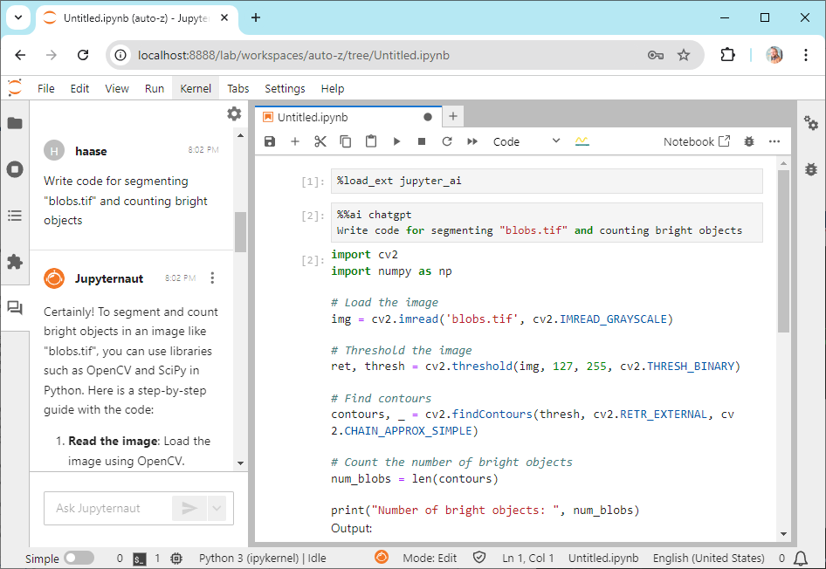
AI Assistants Technical Overview
Integration of LLM functions into existing tools and services
Chatbots on websites
AI assistants in MS365, Adobe Cloud, …
AI assistants in programming environments (IDE, …)
For Jupyter Lab, e.g., via "jupyter-ai" or "bia-bob"
“
Provider
Login with API Key
LLM A
API
blablador/alias-fast
LLM B
Software package or plugin for chat, text or code generation, etc
connected to →
Local Computer
Local LLM Service
Alternative:
Direct local access, needs according hardware performance
API
LLM a

Slide 7
AI Assistants Usage and Limitations
Prompt Engineering
Prompt: Instruction for the AI assistant / LLM to fulfill a task
Formulate as precisely as possible and provide useful context
Iterative modification of the prompt until the desired result is achieved
Limitations
Prompts and context are transmitted to the LLM - when using an external LLM service provider, this means data transmission to external servers, so data protection must be considered!
The AI assistant is only as good as the LLM used in the backend - variations in answer quality, available languages, knowledge level, code generation capability, …
The context window (number of tokens) has limitations and varies depending on the LLM
In this training, we use "bia-bob" (AI assistant for Jupyter) with Blablador (LLM provider Helmholtz / FZ Jülich)
(https://github.com/haesleinhuepf/bia-bob) (https://helmholtz-blablador.fz-juelich.de)

